Slide 1
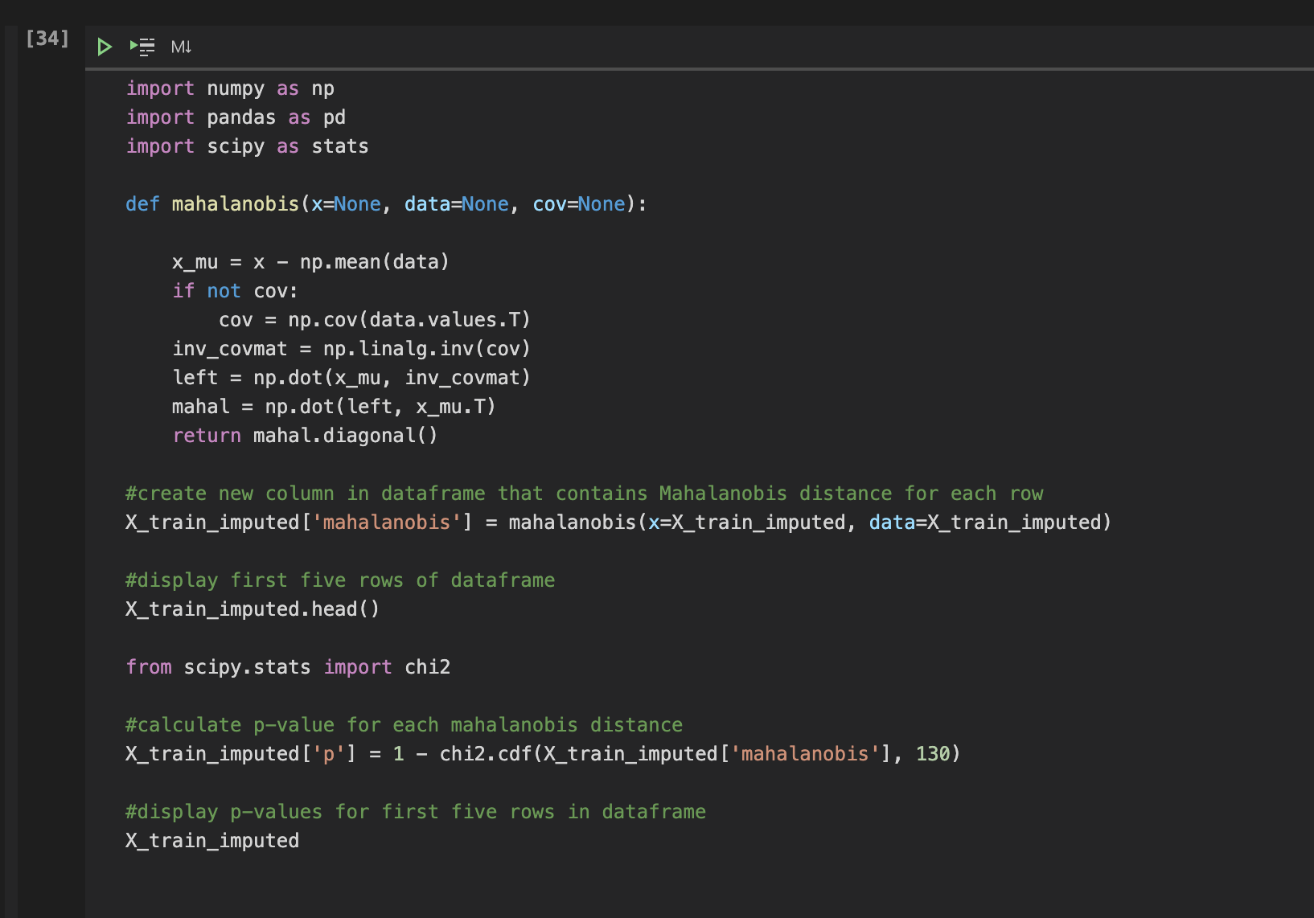

ML in Finance
Investment Strategy Predictions
Machine Learning in Finance FS21 – UZH
Franziska Heusser, Philip Smidt Andersen, Timo Bischofberger, Leon Frielingsdorf, Matteo Gamba
Notes:
© F.Heusser

Slide 2
Main Steps
Evaluation
ML Algorithms
Preprocessing
01
Preprocessing of the Data
02
ML Algorithms
03
Evaluation

Slide 3
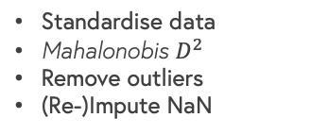
Preprocessing Data
Missing Values & Null Values
Feature Selection
Visualise missing and null values
Drop columns where > 20% missies
Drop columns where > 30% null values
Drop column where stdev = 0
Impute NaN (Iterative Imputer)
Outliers
Feature Selection using Random Forest
Standardise data
Mahalonobis $D^{2}$
Remove outliers
(Re-)Impute NaN
Loading & Merging Data
Load data
Merge data
Look at data
Training - Test split

Slide 4
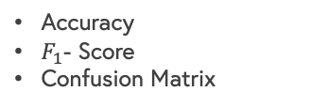
ML Algorithms
Evaluation
Accuracy
$F_{1}$- Score
Confusion Matrix
Function Execution
Function Definition
Train model on training data
Test model on test data
Skicit-learn
Pipeline for the function
Parameters for Hyperparameter Tuning
Grid Search - Cross Validation
Algorithm Selection
Algorithms learned in class (Logistic Regression, Random Forest, Support Vector Machines)
Simple Neural Network (MLP Classifier)

Slide 5
Accuracy
Logistic Regression
Random Forest
Support Vector Machines
MLP Classifier
I 30 | 0.598 |  | 0.559 |  | 0.475 |  | 0.559
B 30 | 0.507 |  | 0.555 |  | 0.497 |  | -
B 20 | 0.513 |  | 0.557 |  | 0.370 |  | -
B 50 | 0.490 |  | 0.536 |  | 0.486 |  | -
I = Imbalanced B = Balanced

Slide 6

$F_{1}$- Score
Logistic Regression
Random Forest
Support Vector Machines
MLP Classifier
I 30 | 0.477 |  | 0.534 |  | 0.470 |  | 0.543
B 30 | 0.491 |  | 0.533 |  | 0.468 |  | -
B 20 | 0.499 |  | 0.537 |  | 0.395 |  | -
B 50 | 0.492 |  | 0.518 |  | 0.485 |  | -
I = Imbalanced B = Balanced

Slide 7
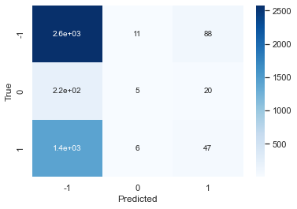
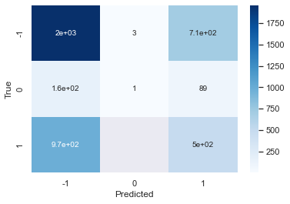
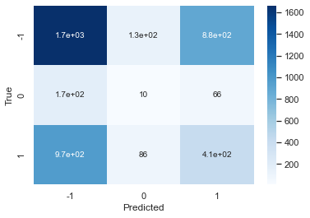
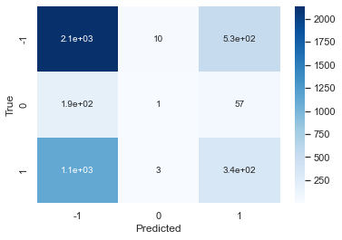
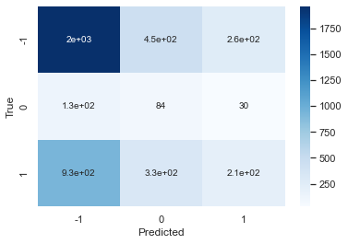
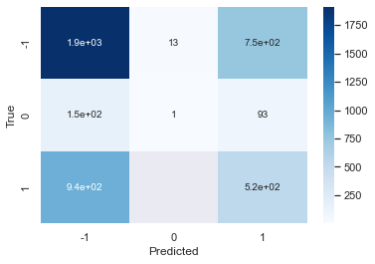
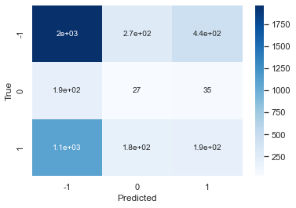
Confusion Matrix
Logistic Regression
Random Forest
Support Vector Machines
MLP Classifier
Imbalanced 30
Imbalanced 30
Imbalanced 30
Imbalanced 30
Balanced 50
Balanced 30
Balanced 30

Slide 8
Improvements
Preprocessing
NaN MCAR?
PCA for outlier detection
Feature engineering
ML Algorithms
Hyperparameter tuning
Multi-layered neural network
Other ML algorithms
Evaluation & Financial Theory
Regression of stock performance
Custom evaluation metric
Implementing needs of specific investors

Slide 9
Thank you.
For any inputs,
please contact us
Franziska Heusser, Philip Smidt Andersen, Timo Bischofberger, Leon Frielingsdorf, Matteo Gamba

